Slide 1

Travel management system”
Software Requirement Specifications
Prepared by
Muhammad Taha Jawaid

Slide 2

Our Goals:
Reduce and Eliminate Expenses
Minimize the time factor
Efficient planning and goals

Slide 3
Introduction
“Travel and Tourism Management” system is basically a system which will be used to book the touring destinations and hotels all around the globe with the help of simple and efficient desktop based application The purpose this system i.e. “Travelling Management System” is to register the users who want to travel to different places from all over the globe with a specific and efficient platform from which they can easily book, add, update their rides and hotels according to their choices.

Slide 4
Purpose:
The purpose of this document is to elaborate the details of TMS. Since “Travelling Management System” is an easiest and single platform through which a user can efficiently use it to perform all functionalities of booking from bottom to top (i.e. from registration to till payment). Some basic features that TMS shall provide to the user is that all the travelers can easily book the package/trip and can get all the required details of it by some clicks. The tourism management system will allow the user to access all the details i.e. location, events, statistics and reports etc.
FISH BONE

Slide 5
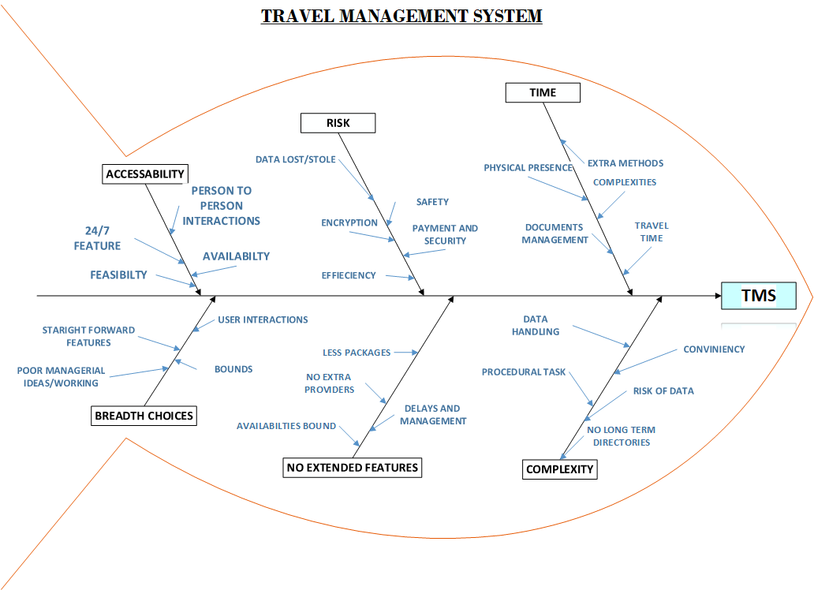

Slide 6
For whom the system is made for?
People who are willing to explore things and check packages.
Media.
Educational Institutes.
Business Travelers.
Multiple Travel Agencies.
Booking Engines.
Travel Guide & Agencies.

Slide 7
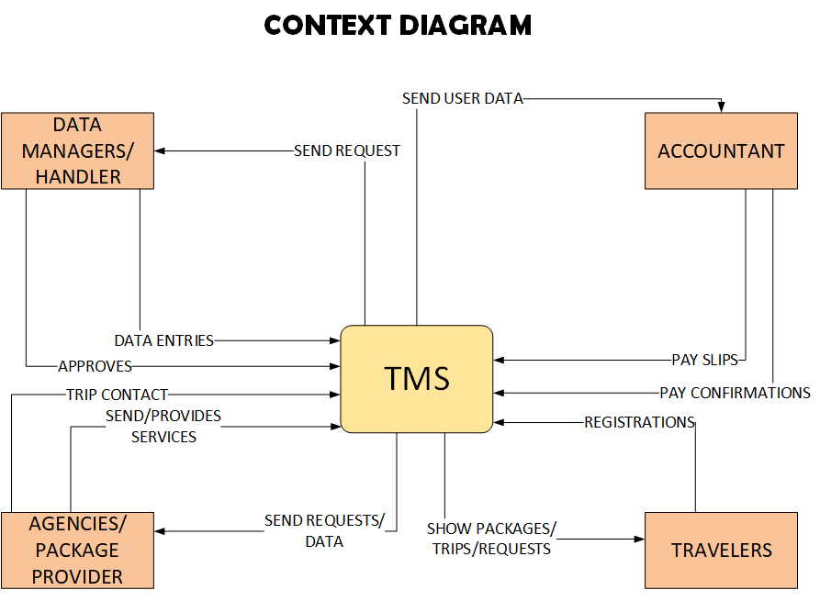
Project Scope:

Slide 8



Our Vision:
The system “Travel management system” is for the customers who want to register themselves online and book their desire places and hotels through a specific application. The Travel management system is an online, simple and efficient system which will help the users(travelers) to register themselves in order to book the various places where they want to travel. Travel management system users will have the advantage to book their tickets on time, will have the advantage of paying the amount online, will have the advantage of receiving the digital slips of different purchases they will do.

Slide 9
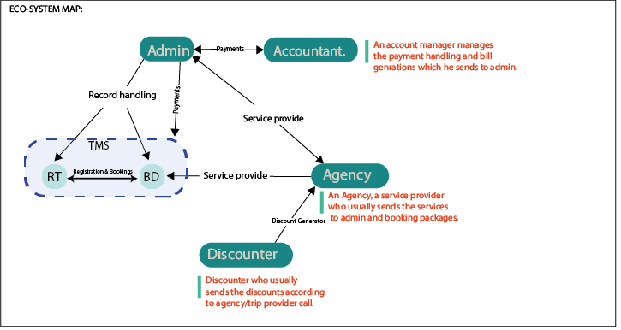
System perspective:

Slide 10
Product Functions:
The system will perform various functionality according to the user. Like for travel management system there will be different type of user which are:
Main users(admin and end user)
Other user(accountant and agencies)

Slide 11
User-ended functions:
The User Registrations: The user can add the details for the registration. Basically it’s an end-to-end encryption between user details and database in order to keep user details secure.
Data update: The user can update the data according to requirements and approvals from the admin. Moreover, the database should be checked and updated after the user perform registration or data entries.
Search the trip/package/location details: The user can search for any specific key for trip/location/package. In response the system shall show him the appropriate details with correct providers and contact.
Feedback: The system shall generate the feedback form according to the user according to the interaction with the system which can be filled up by the user.
Cancelation of a trip: A user can cancel his trip. If a user wants to cancel his/her trip, then the system shall provide/send the information to admin so that his trips can be canceled.

Slide 12
Admin-Ended functions:
Package track/statistics: Admin shall be able to send the or update the user trip tracks/statistics after each action he/she perform on the application.
Package Creation: Admin shall be responsible for creating the required package for the user and then generate a specific slip that will be sent to the user.
Ticketing Reservations: The Admin shall check the details of user then he should send the slip of ticket reservation to the required user.
Update details: After registering if user want to update his/her details then the Admin shall make the changes into the database and then send the update confirmation to user through system.
Slip generation: Admin shall check the payments and send the details to account class so that he can generate the Slip of payment that shall be sent to the user which he/she can easily printout anytime.

Slide 13
Agency-Ended functionality:
A agency member can upload the various packages according to filters.
A agency member can send the package details
A agency member is responsible to provide the tickets amounts
A agency member can update the trip routes to admin
A agency member can set the prices on their packages
A agency member can provide multiple facilities with packages

Slide 14
Accountant functionalities:
An accountant can check for payments.
An accountant can generate pay slips.
An accountant can add charges according to regions at the payment time and can manage all the payment records of the users.
An accountant can check for dues and pay order link with admin.

Slide 15
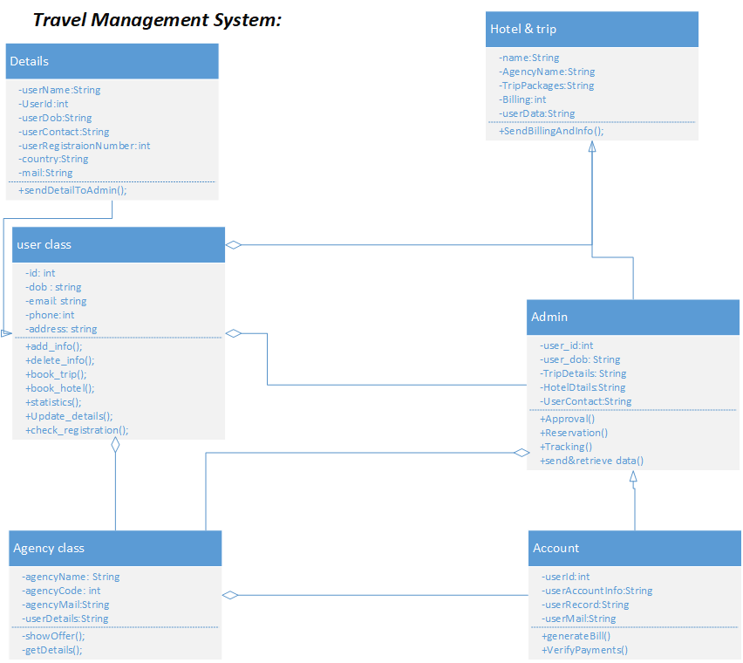
Class Diagram:

Slide 16
Operating Environment:
Windows xp.
Windows 07
Windows 08
Linux
Windows 10/11
Mac/MacOs

Slide 17
Design and constraint for the system:
The System should be implemented through a specific and efficient language like java or kotlin
The UI of the system should be consistent and should be responsive on all devices.
Without internet connection the user cannot access the system. Hence its mandatory to have a stable internet connection.
There should be at least 1 GB of ram on the system.
Every user should be given a specific/unique user ID in order to prevent from unauthorized logins.
As monthly system updates will happen after every 1 month so data should be saved before updating the system else the update will not occur.
Except “google travel” no other APIs should be used while making the system.
Web-based, Desktop-based or Smart-phone based system should use the camera access in order to capture the user details.
There should be an inter linking between printer functions and the payment slip functions. So that user will be able to get the slips immediately.
The system should have an OTP confirmation while login to the application.

Slide 18
Application should be light and memory efficient that it will not cause the user to frustrate.
There would be no more than 1-minute wait for any function that user will perform
Payment feature should contain multiple payment options (visa, MasterCard, PayPal etc.)
As per Government information the application should launch in specific regions first.
The system should support bilingual language option with a simple Chabot.
There should be a unique Id and password for each of the user that will be change on monthly basis.
System should be connected through database in order to save information.
System shall not charge any additional charges for national users.

Slide 19
Assumptions and dependencies:
Assumptions:
The compilation of code should be without the flaws
The data should be recorded into data base so that each user can access the record easily
The system should be memory efficient
Each user should have the unique id or password.
User-friendly and efficient design should be implemented in the system
User should not use any special characters while communicating with the system
The system should be workload efficient with more than 20 users else it should say the error of server down

Slide 20
Assumptions and dependencies:
Dependencies:
The system should be run on windows application means it will not work on different web services.
The database should be connected for the registration of the users
In order to run the system the device should have minimum specs.
The system shall start the process after the confirmations and approval from user.
In order to fetch packages the system shall access them from the multiple agencies system.
The admin system should be connected with both database and account/bank system in order to manage the things or data.
The payment should be done through PayPal or any secure service.

Slide 21
Interfaces

Slide 22
Hardware-Interface
 |  | For PC | For MAC
Ram | At least 256 MB or more |  | At least 256 MB or more
Internet connection | 500+ Kbps |  | 500+ Kbps
Processor | 500 MHz or faster |  | 1.8MHz intel core duo or faster
Bits | 16 bits or more |  | 16 bits or more
Operating System | Windows XP of higher with latest updates installed |  | Mac OS 10.3 or higher with latest updates installed
Video card | At least of 75 MB of video card |  | At least 75 MB of video card
Versions | Windows 10 or more |  | Version 10.7 or more
Memory | SSD |  | SSD

Slide 23
Interfaces: Software-Interface
The software uses windows and operating system. This software uses SQL database for data of flights, tours and hotel. GUI will be used in this software.
The software has different types of interface like,
Graphical user interface
As system has most of interfaces has a visual way of interacting with user graphically.
Menu-driven interface
As system has many menus in it like hotels, tours and etc.
Form base user interface
Many forms are being used in system like login page, signup page and etc.
Touch user interface
User interact with system using touching.

Slide 24
Features:
Customer care support facility.
Availability
Online and easy payment
Wider tools/option facility
Discounts
Breadth choices
Efficiency

Slide 25
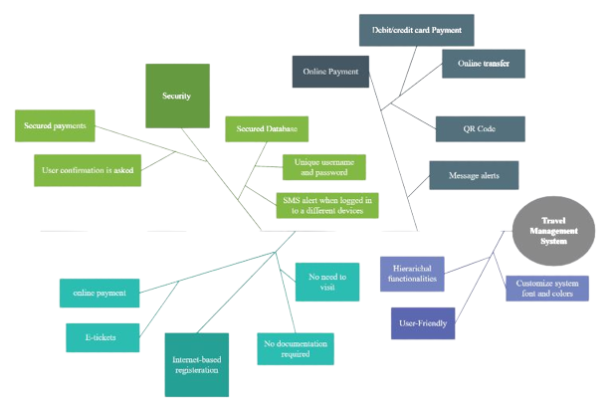
Features:

Slide 26
Non-functional Requirement

Slide 27
Performance Requirements:
PERFORMANCE REQUIREMENT:
5.1.1) The user should not wait for a long time after performing some task. He will get the response as soon as possible.
5.1.2) The system should contain an interactive and user friendly interface and the functionalities that have been used in the system, should be easily understandable by the user.
5.1.3) If the user faces some type of difficulties/queries while using the system, so there is a help desk where he can resolve his queries with in minimum time.
5.1.4) The system should be effective, so the user should not feel any difficulty while using the system.

Slide 28
Safety Requirements:
SAFETY REQUIREMENT:
5.2.1) The password should contain 8 characters i.e. 2 upper case letters, 3 lower case letters, 2 numeric letters and 1 especial letter.
5.2.2) If the user wants link with another system the system should ask for the user confirmation whether he wants to share his data or not.
5.2.3) In the system there should be exception handling for any of the error occurred when the system is running.
5.2.4) In the system there should be a backup or recovery system if the user performs some wrong action by mistake, so he should have an option to go back or recover.

Slide 29
Security Requirements:
SECURITY REQUIREMENT:
5.3.1) The system should have the property of confidentiality; the system should secure the access to user’s data and personal details.
5.3.2) There should be a two-way process between the user and the system while login (the user while entering his username and password it should tell that whether it is right or wrong).
5.3.3) The should check that the user is registered/authorized, if he is not registered user then the system should the user to register yourself.
5.3.4) The system should ensure that the user’s personal data should not be leaked and also ensure that the data should not be misused.

Slide 30
Software Quality Attribute
SOFTWARE QUALITY ATTRIBUTE:
5.4.1) Usability: The system should be user friendly like when the user uses the system for the first time, he will not face any type of difficulty to use the system and the system should be maintainable i.e. if the customer wants to make certain changes in the system so the system should accept that changes.
5.4.2) Efficiency: The system should be capable enough to manage work load like when the user performs some task so the system should complete that task in few seconds without any delay.
5.4.3) Reliability: The system should ensure that when the user performs some action so some output should be come rather than system fails that action.
5.4.4) Integrity and testability: The system should be capable to handle/stop unauthorized logins and some illegal and malware actions perform by the user and send the message of alert to the control room of the system.
5.4.5) Portability: The system should be portable and can work on multiple-platforms without any disturbance and lagging. It also includes the behavior and cost of implementation of the system at any particular area.

Slide 31
Business Rules

Slide 32
Business rules:
Facts
Action enablers
Constraints
Inference
Computations

Slide 33
Facts
Every member should have a unique id
There will be a Unique Serial Code given to every user from which they can get discounted coupon.
Tax will be charged if user is outside the country
Generation of payment slip will be shown after completing all the prerequisite.
In order to access system internet connection is mandatory.
Additional charges will be for any facility user want in his package.
OTP confirmation while login and doing payments.
Email should be unique
Password should be unique
Tickets should be reserved after checking the id and email of each user.

Slide 34
Action enablers
If the all the flights that user want is not there or full then send a feedback to user
If the user serial code is expiring in few days, then he should request so that new serial code should be given
Show different agency packages related to user range that he entered
If payment has been submitted, then show the slip.
If user request for registration has approved, then send him different details from he can book or add
Email configuration should be sent if the user is signing up for the first time on the system
Show the flight details to the customer after according to the packages and price
If user enter the correct OTP, then the system should send him to registration page

Slide 35
Constraints
Without “CNIC” and “E-MAIL” user can’t add details
System shall not calculate the payment without unique id
At a time, user can only book for 1 person
No user can select more than 1 package
Without backup user data can be lost
External users can only read the system state
Without the id and number, the details can’t be added
Only admin can accept the approvals for package booking
Without OTP a user can’t login into

Slide 36
Inference
. If the user doesn’t add her details for the next 2 weeks after signing up, system should consider his id delete.
2. The serial code will be considered as expiry if user don’t use it between the period of 1 month
3. If the user does not pay the bill, then system should auto ban him
4. If selected price from user is high, then system should be considering him to follow business class packages else should considering to follow middle class packages.
5. If admin is not responding to user request, then user should consider to try again later
6. The system will cancel the flights or packages if the given data is wrong on authorization.
7. System should consider a user a black-user for year if he/she not pay the bill.
8. If user can’t login to the system, then the system should consider him/her a new or fresh user/customer.

Slide 37
Computations
The total bill of the user should be generated from the sum of the number of ticket with the total amount of packages he bought.
The package activity percentage of a certain user shall be calculated by total number of activities divided by total number of days spent multiplied by hundred. As a result, this will generate the activity percentage for the user.

Slide 38
Other Requirements:

Slide 39
Internal quality requirements
Efficiency:
The system should use less memory usage.
The system should be capable of managing the big data at a single time.
The system should be capable enough to handle the huge traffic.
The system should give the pop up to user if he enters the wrong pin or the time of OTP exceeds
Supportability:
The system should manage the workload of the print copies if user try to print the copy of slip from his pc
As the system support printer facility as well so the system should generate run time messages if the user stuck at some point
There should be performance and efficiency functionalities use whenever user tries to give commands from his portal system.

Slide 40
Internal quality requirements
Portability:
The system should support the application working on mac as well.
After first two release the system will be switched for web and mobile based interface without changing much things
The system shall build on cross platform products so that it would be easy to deal that system on other systems with changing its internal state again and again.
There shall be an inter link with web browser as well so that there will be no problems while going for feedbacks or emails.
Scalability:
The system should be capable enough to perform according to the ram size.
The system should add 10 tables after each 100 registrations in order to minimize load factors.
System should customize itself according to the given user commands.
Agencies should be added to user account according to their needs so that there will be maximum efficiency factor.

Slide 41
Analysis Models

Slide 42
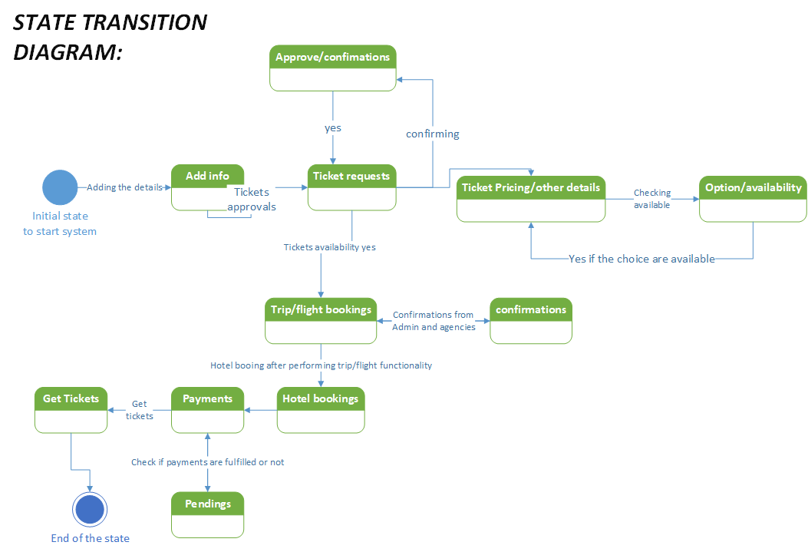
State transition:

Slide 43
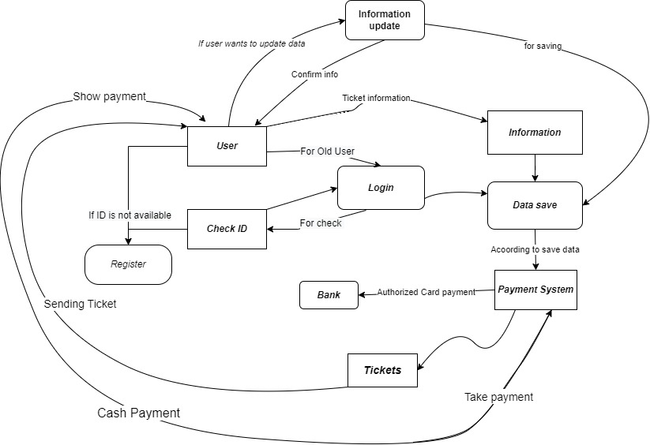
Level Zero diagram:

Slide 44
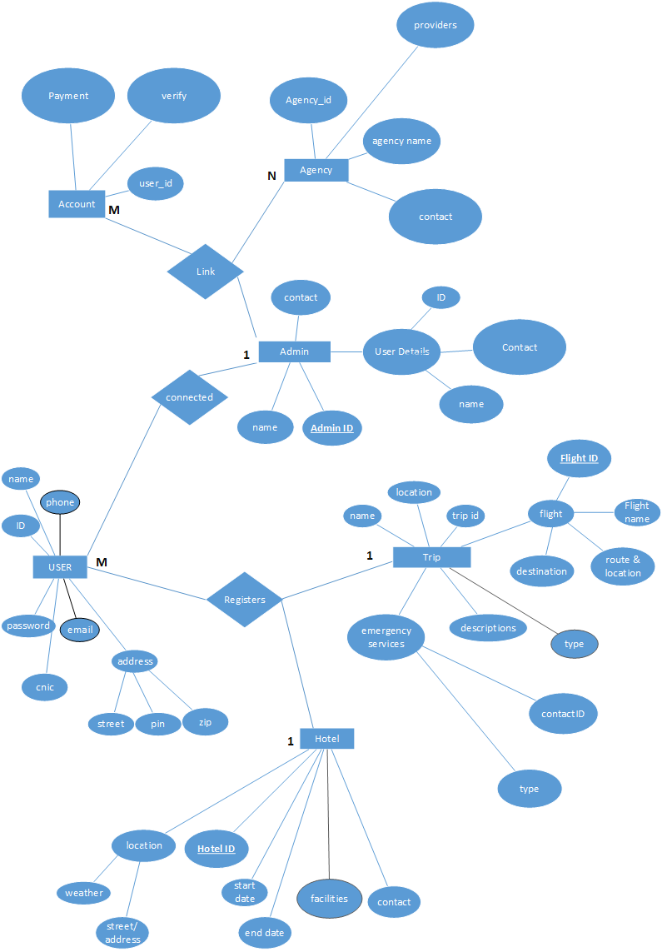
Entity Relationship Diagram

Slide 45
Prioritizing Requirements

Slide 46
Weigers Chart
Relative Weights : | 2 | 1 |  |  | 1 |  | 0.5
Feature | Relative benefit | Relative penalty | Total value | Value% | Relative cost | Cost% | Relative risk | Risk% | Priority
Give Breadth Choices to user to communicate better | 5 | 2 | 12 | 11.5% | 3 | 12% | 1 | 6.6% | 0.269
Wider Tools to follow the multiple provider and selections | 3 | 5 | 11 | 10.5% | 6 | 24% | 2 | 13.3% | 0.0615
Online payments methods | 9 | 1 | 19 | 18.2% | 5 | 20% | 3 | 20% | 0.113
Generate the payment slips | 8 | 1 | 17 | 16.3% | 3 | 12% | 3 | 20% | 0.169
Budget Friendly packages generation by agencies | 5 | 4 | 14 | 13.4% | 2 | 8% | 2 | 13.3% | 0.314
Provide Customer care support | 7 | 1 | 15 | 14.4% | 5 | 20% | 1 | 6.6% | 0.135
Give Discount on packages | 7 | 2 | 16 | 15.3% | 1 | 4% | 3 | 20% | 0.239
Totals | 44 | 16 | 104 |  | 25 |  | 15

Slide 47
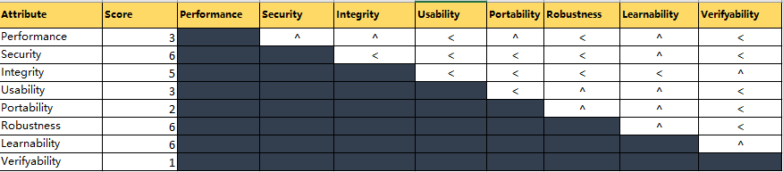
Quality requirement prioritizing

Slide 48
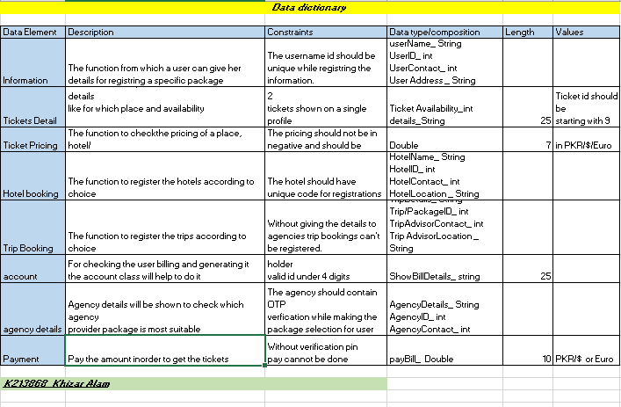
Data Dictionary for the requirements

Slide 49

Thank you

